Slide 1
Chapter 3 Lecture 2 : Falling droplets and rising bubbles 12 february 2021
Content :
In stagnent fluid (3.1.3)
In flowing fluid (3.1.5)
Constrained by walls (3.1.4)
Training exercise 3.2

Slide 2
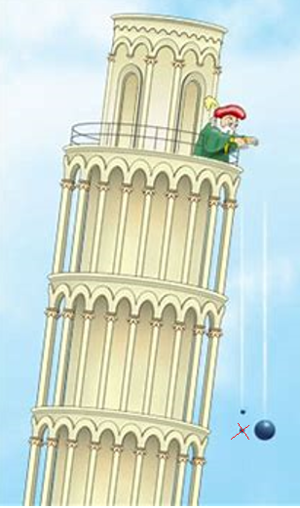
Falling objects (continue from lecture 3.1)
Aristoteles: Heavier objects fall faster
Galilei’s experiment (here corrected):
Who was right?
Class room experiment…..

Slide 3
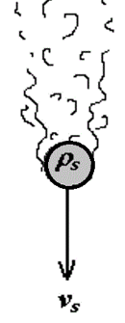
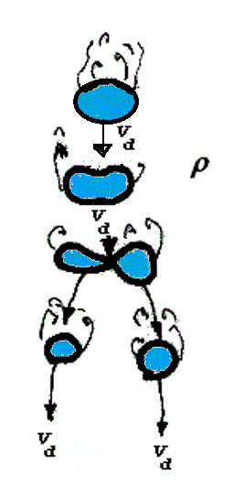
Droplets in stagnent gas (3.1.2)
Solids (lecture 3.1)
Droplets

Slide 4
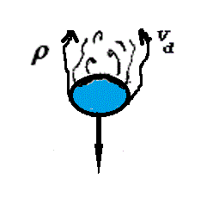
Maximum droplet size: Dimension analyzes
Turbulence disrupts drops, disruptive force
Surface tension holds drops together
cohesive force around circumference:
Balance between cohesive and disruptive forces, quantified by
Weber number:

Slide 5
Size and sinking velocity
Solid particles (3-1)
Droplet size, related to Weber number:
→sinking velocity

Slide 6
A very rough application
Consider: Thunder shower. Droplet size may be : 5mm ???
Fully turbulent boundary layer: Re>500 → fs= 0.44
Velocity
Weber number:
Published for droplets in stagnent gas: Kd =2.75-3.1 (-)
Bubbles in stagnent liquid : K_{b} = 1.53.

Slide 7
Droplets in turbulent flow (3.1.5)
Weber number considering turbulent fluctuations:
Fluctuations proportional to energy dissipation:
Dissipation due to wall friction:
→
Experimentally: C=0.725

Slide 8
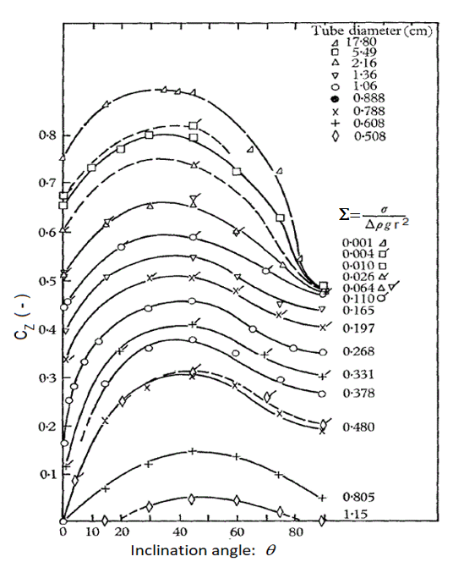
Bubbles constrained by pipe walls (3.1.4)
Analytic solution by Dumitescu, dimension analyses by Taylor.
( Vertical pipes, neglecting viscosity and surface tension)
Extensions by Zukoski
Dimensionless surface tension

